Slide 1
FAST!
An introduction
www.francenzst.org/join-us

Slide 2
WHO WE ARE
FAST! is a not-for-profit New Zealand incorporated society open to all science, technology and innovation minded people. We welcome members from New Zealand and France, from experienced practitioners to emerging professionals and students.
OUR mission
→ To structure and strengthen the collaboration between France and New Zealand to foster science advances and enhance mutual exchanges in science and innovation.
→ To encourage a dynamic collaborative environment that supports science endeavours
FAST! is supported by
The Embassy of France in New Zealand
The France - New Zealand Friendship Fund
Campus France

Slide 3
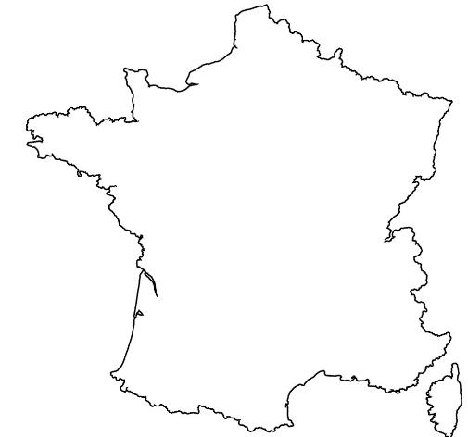
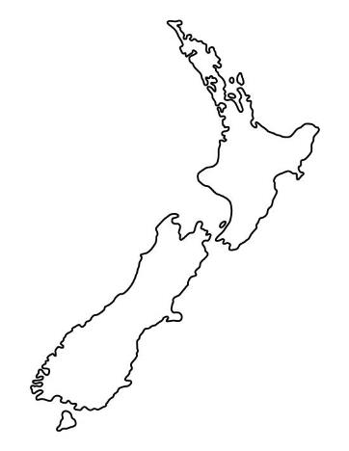
WHAT WE DO
We hold a yearly event
We support the Café Scientifique in partnership with the Alliances Françaises and the French Embassy
The Vincent Salomon FAST! Travel Award
→ To support New Zealand post-grad student or early career scientist to attend science-related conference in France.
→ Two scholarships will be awarded to support expenses up to $2000.
This award aims at encouraging New Zealand participation in FAST!
FAST! Student Conference Award

Slide 4
Contact us:
Contact us : francenzst@gmail.com

